Slide 1
Overview about cellular network

Slide 2
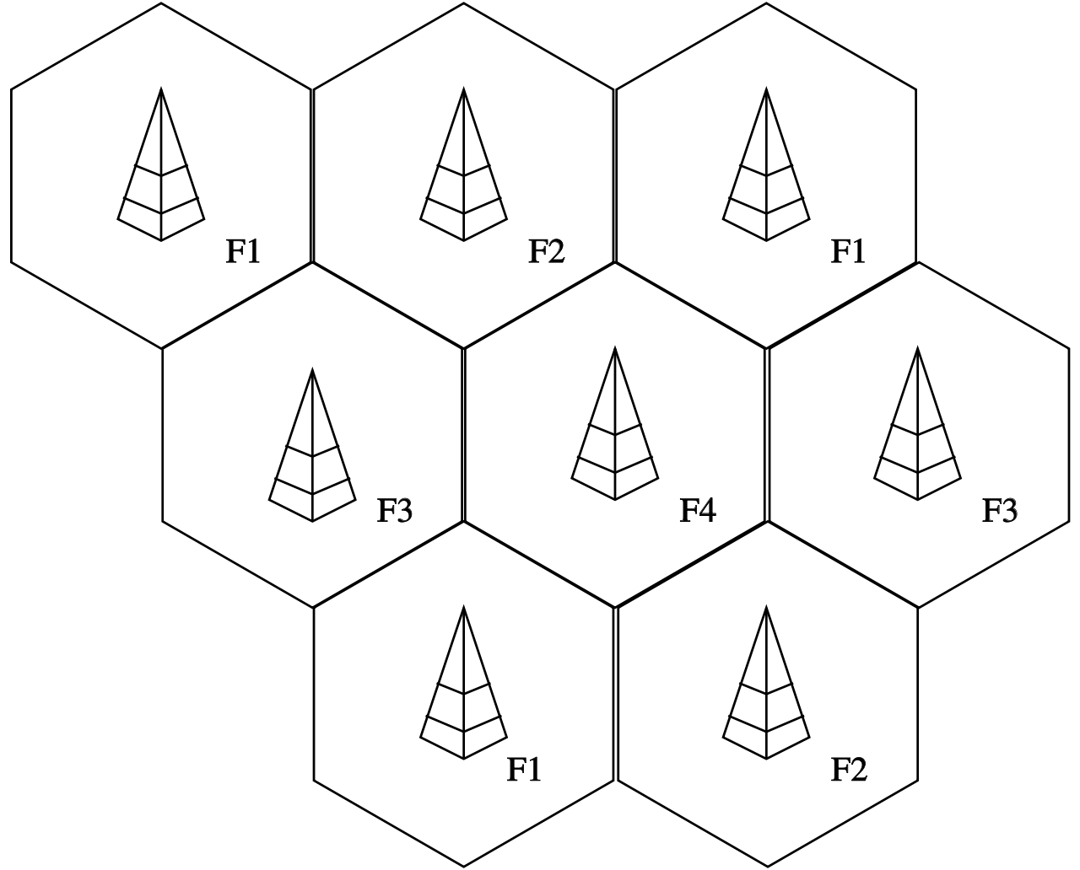
The general definition and benefit
- A cellular network or mobile network is a communication network where the last link is wireless.
- The network is distributed over land areas called cells, each served by at least one base station.
-The base station provide the cell with the network coverage which can be used for transmission of voice, data, and other types of content.
Advantage features of cellular network
- More capacity than a single large transmitter
- Mobile devices use less power than with a single transmitter or satellite since the cell towers are closer
- Larger coverage area than a single terrestrial transmitter

Slide 3
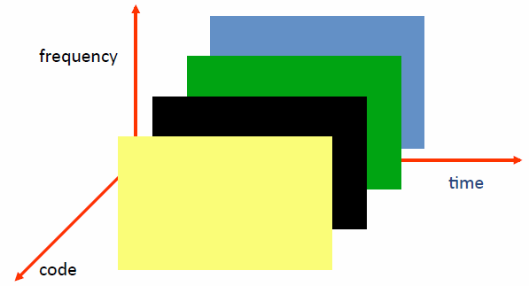
Multiple Access Schemes
Example for schemes:
Frequency Division Multiple Access (FDMA)
Time Division Multiple Access (TDMA)
Code Division Multiple Access (CDMA)
Orthogonal Frequency Division Multiplexing (OFDM)
Single Carrier Frequency Division Multiple Access (SC-FDMA)

Slide 4
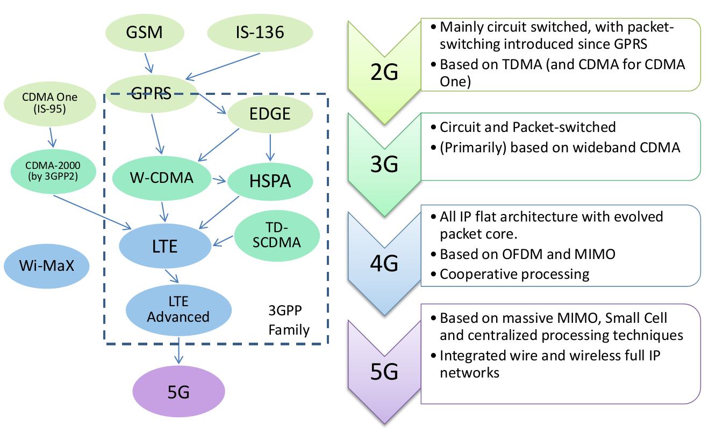
Evolution of Cellular Networks

Slide 5
Service Roadmap
Improved performance, decreasing cost of delivery
3G-specific services take advantage of higher bandwidth and/or real-time QoS
Broadband
in wide area
Video sharing
Video telephony
Real-time IP
multimedia and games
Multicasting
A number of mobile services are bearer independent in nature
Multitasking
WEB browsing
Corporate data access
Streaming audio/video
MMS picture / video
xHTML browsing
Application downloading
E-mail
Voice & SMS
Presence/location
Push-to-talk
Typical average bit rates
(peak rates higher)
GSM
9.6
kbps
GPRS
171
kbps
EGPRS
473
kbps
WCDMA
2
Mbps
HSDPA
1-10
Mbps
CDMA
2000 1x
CDMA
2000-EVDO
CDMA
2000-EVDV

Slide 6
2G Overview
2G (or 2-G) is short for second-generation cellular technology which use digital radio signal.
2G network is divided into two branch base on multiple access technology: TDMA(Time Division Multiple Access) and CDMA (Code Division Multiple Access)
Some GSM frequency bands: GSM-450, GSM-480, GSM-710, GSM-750, GSM-850, GSM-900, DCS-1800,…etc

Slide 7
GSM Services
    Voice, 3.1 kHz
Short Message Service (SMS)
  1985 GSM standard that allows messages of at most 160 chars. (incl. spaces) to be sent between handsets and other stations
  Over 2.4 billion people use it; multi-billion $ industry
General Packet Radio Service (GPRS)
  GSM upgrade that provides IP-based packet data transmission up to 114 kbps
  Users can “simultaneously” make calls and send data
  Performance degrades as number of users increase
  GPRS is an example of 2.5G telephony

Slide 8
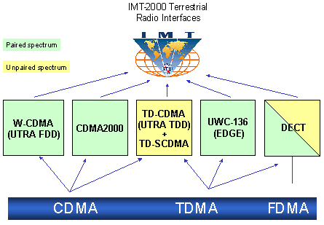
3G Overview
3G is created by ITU-T and is called IMT-2000

Slide 9
Evolution from 2G
2G
IS-95
GSM-
IS-136 & PDC
GPRS
2.5G
IS-95B
HSCSD
EDGE
Cdma2000-1xRTT
W-CDMA
3G
Cdma2000-1xEV,DV,DO
EDGE
TD-SCDMA
Cdma2000-3xRTT
3GPP2
3GPP

Slide 10
UMTS
Universal Mobile Telecommunications System (UMTS)
UMTS is an upgrade from GSM via GPRS or EDGE
The standardization work for UMTS is carried out by Third Generation Partnership Project (3GPP)
Data rates of UMTS are:
  144 kbps for rural
  384 kbps for urban outdoor
  2048 kbps for indoor and low range outdoor
Virtual Home Environment (VHE)

Slide 11
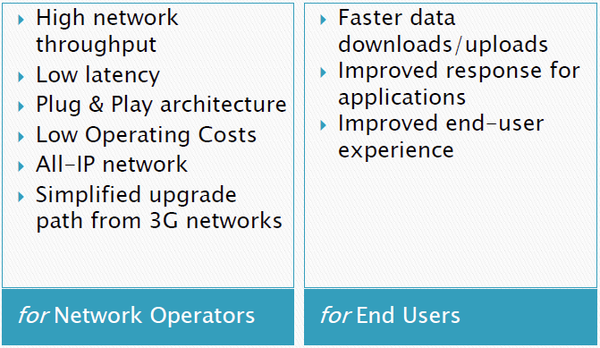
4G LTE

Slide 12
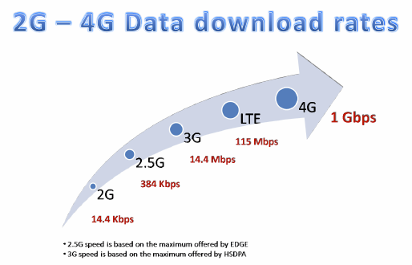
Comparison of LTE Speed

Slide 13
Major LTE Radio Technogies
Uses Orthogonal Frequency Division Multiplexing (OFDM) for downlink
Uses Single Carrier Frequency Division Multiple Access (SC-FDMA) for uplink
Uses Multi-input Multi-output(MIMO) for enhanced throughput
Reduced power consumption
Higher RF power amplifier efficiency (less battery power used by handsets)

